Slide 1

ONE WEEK
DATA SCIENCE

Slide 2

MODEL OPTIMIZATION

Slide 3
PROJECT OVERVIEW

Slide 4

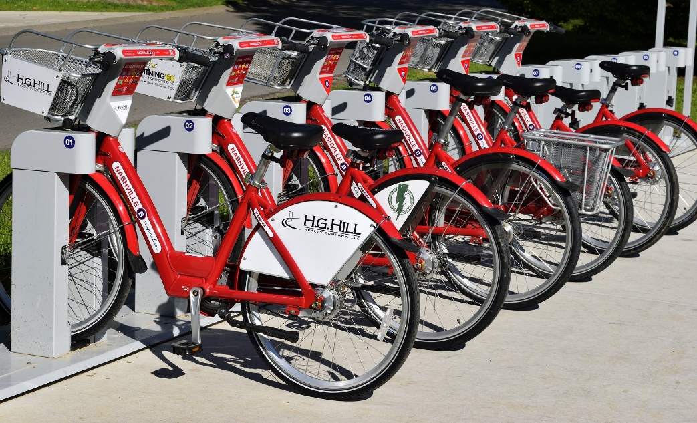
PROJECT CARD
GOAL:
Build, train, and test a machine learning model to predict bike rental usage based on inputs such as temperature, humidity, wind speed..etc.
We will train a model and optimize its hyperparameters using SK-Learn.
TOOL:
Jupyter notebooks, Google Colab, and Sklearn
PRACTICAL REAL-WORLD APPLICATION:
This project can be effectively used by bike rental shops to predict demand and expected future sales and understand key factors that contribute to generating revenue.
DATA:
INPUTS:
Instant, date, season, year, hour, month, holiday, weather situation, temperature, and windspeed.
OUTPUT:
casual: count of casual users
registered: count of registered users
cnt: count of total rental bikes including both casual and registered
Image Source: https://pixabay.com/photos/bike-rental-bikes-rent-pay-2284380/
Dataset Source: Hadi Fanaee-T, Laboratory of Artificial Intelligence and Decision Support (LIAAD), University of Porto INESC Porto, Campus da FEUP Rua Dr. Roberto Frias, 378 4200 - 465 Porto, Portugal

Slide 5
MODEL OVERVIEW
TEMPERATURE
WEATHER
OPTIMIZED REGRESSION MODEL
WINDSPEED
SEASON
BIKE USAGE COUNT (TOTAL)
MONTH

Slide 6
DATA EXPLORATION: INPUTS & OUTPUTS
Outputs:
casual: count of casual users
registered: count of registered users
cnt: count of total rental bikes including both casual and registered
Inputs:
instant: record index
dteday: date
season: season (1: springer, 2: summer, 3: fall, 4: winter)
yr: year (0: 2011, 1: 2012)
mnth: month ( 1 to 12)
hr: hour (0 to 23)
holiday: whether day is holiday or not - weekday : day of the week
Working day: if day is neither weekend nor holiday is 1, otherwise is 0.
weathersit :
1: Clear, Few clouds, Partly cloudy
2: Mist + Cloudy, Mist + Broken clouds, Mist + Few clouds, Mist
3: Light Snow, Light Rain + Thunderstorm + Scattered clouds, Light Rain + Scattered clouds
4: Heavy Rain + Ice Pallets + Thunderstorm + Mist, Snow + Fog
temp: Normalized temperature in Celsius. The values are divided to 41 (max)
windspeed: Normalized wind speed. The values are divided to 67 (max)

Slide 7
MODELS HYPER-
PARAMETERS 101

Slide 8
HYPERPARAMETERS VS. PARAMETER
Hyperparameter optimization is a key step in developing any machine learning project.
After training multiple models, you would like to fine tune them so that they perform better on a given dataset.
HYPERPARAMETER
PARAMETER
Parameter: values that are obtained by the training process such as slope and Y-intercept or network weights and biases.
Hyper parameter: values set prior to the training process such as learning rate.

Slide 9
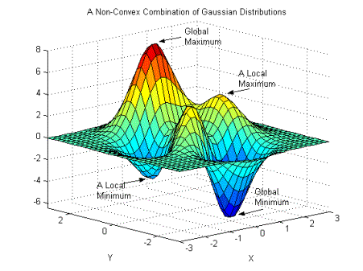
LEARNING RATE
Learning rate is a hyperparameter that represents the size of the steps taken which indicates how aggressive you’d like to update the parameters.
If learning rate increases, the area covered in the search space will increase so we might reach global minimum faster. However, we can overshoot the target.
For small learning rates, training will take much longer to reach optimized weight values
Photo Credit: https://commons.wikimedia.org/wiki/File:Non-Convex_Objective_Function.gif

Slide 10
MODEL TUNING/
OPTIMIZATION STRATEGIES

Slide 11
MODEL OPTIMIZATION STRATEGIES
Three widely adopted strategies are as follows:
Grid Search
Randomized Search
Bayesian Optimization

Slide 12
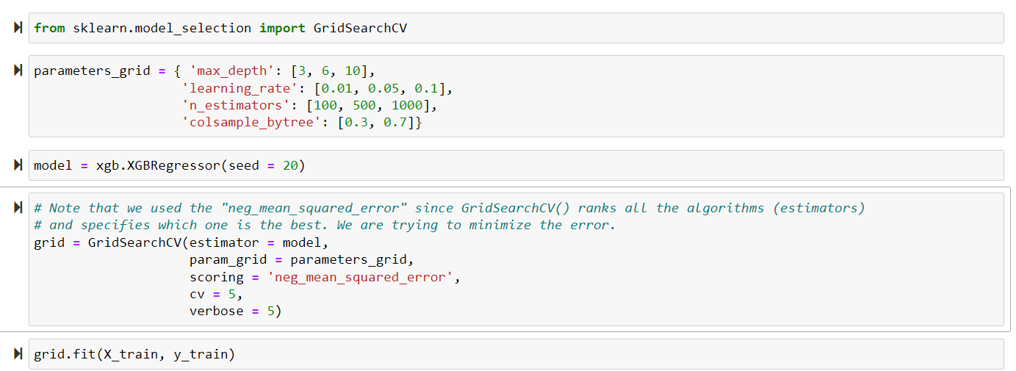
1. GRIDSEARCH
GridSearch performs exhaustive search over a specified list of parameters.
You provide the algorithm with the hyperparameters you’d like to experiment with and the values we want to try out.
Note that you will have the following number of combinations: 3 * 3 * 3 * 2 = 54.
We will run each combination 5 times since we set the crossvalidation = 5.
Total number of runs = 54 * 5 = 270

Slide 13
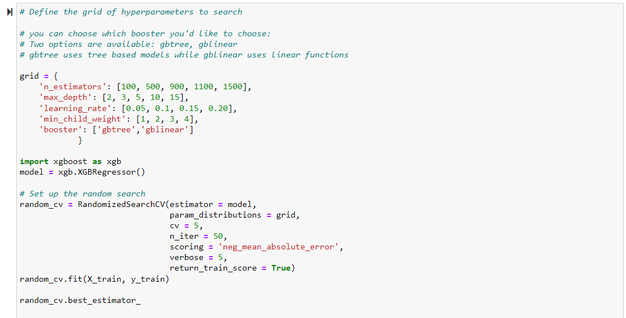
2. RANDOMIZED SEARCH
Grid search works great if the number of combinations are limited.
In scenarios when the search space is large, RandomizedSearchCV is preferred.
The algorithm works by evaluating a select few numbers of random combinations.
You have the freedom and control over the number of iterations.

Slide 14
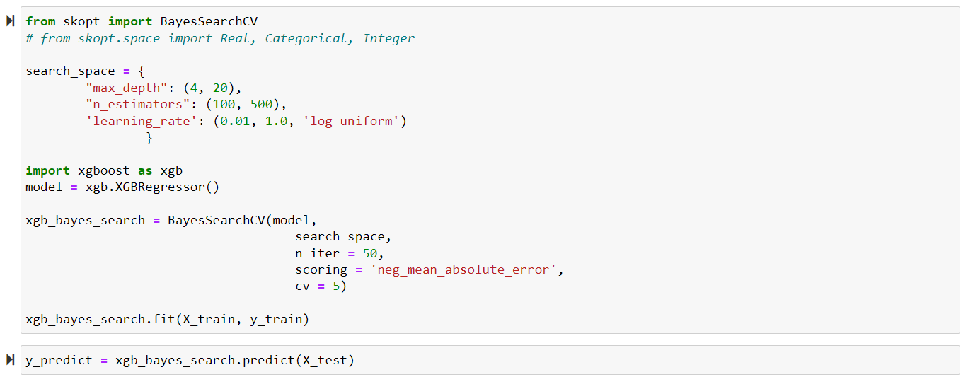
3. BAYESIAN OPTIMIZATION
Bayesian optimization overcomes the drawbacks of random search algorithms by exploring search spaces in a more efficient manner.
If a region in the search space appears to be promising (i.e.: resulted in a small error), this region should be explored more which increases the chances of achieving better performance!
You will need to specify the parameters search space.

Slide 15
MODEL OPTIMIZATION DEMO

Slide 16
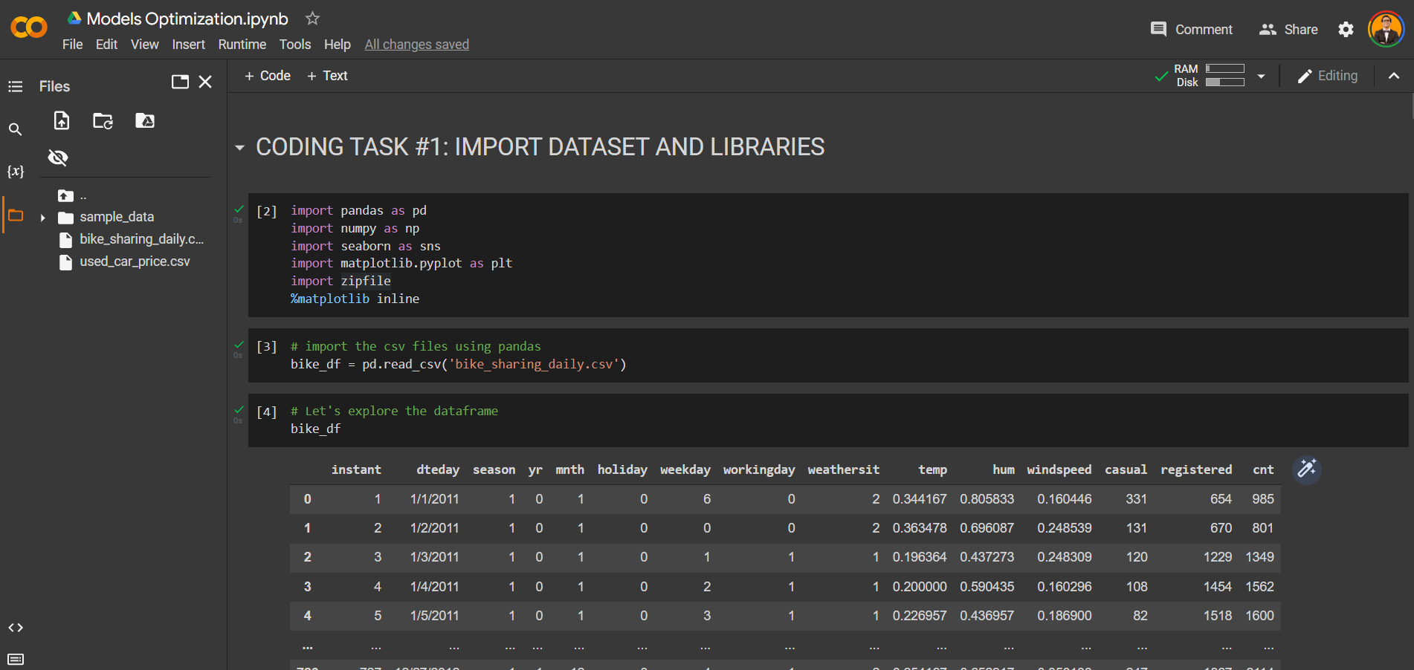
HYPERPARAMETERS OPTIMIZATION DEMO

Slide 17
FINAL CAPSTONE PROJECT

Slide 18
PROJECT
Using the used car prices dataset included in the course package, perform the following:
1. Load the “used_car_price.csv” dataset
3. Split the data into 75% for training and 25% for testing
4. Train an XG-Boost model in Scikit-Learn
5. Assess trained XG-Boost model performance using RMSE and R2
6. Perform hyperparameters optimization using GridSearch, choose any reasonable values for max_depth, learning_rate, n_estimators, and colsample_bytree. Use 5 cross validation folds.
7. Perform hyperparameters optimization using RandomSearch, choose any reasonable values for max_depth, learning_rate, n_estimators, and colsample_bytree. Use 5 cross validation folds and 100 iterations.
8. Perform hyperparameters optimization using Bayesian optimization, choose any reasonable values for max_depth, learning_rate, n_estimators. Use 5 cross validation folds and 100 iterations.
9. Compare the 3 optimization strategies using RMSE and R2.

